Slide 1
Civil Service Feedback Loop Project
THE FIRST STUDY OF CIVIL SERVICE CULTURE IN UKRAINE
IN COLLABORATION WITH FRANCIS FUKUYAMA AND THE GOVERNANCE PROJECT AT THE CENTER ON DEMOCRACY, DEVELOPMENT, AND THE RULE OF LAW,
STANFORD UNIVERSITY

Slide 2
Who we are?
Professional Government Association of Ukraine
Kyiv School of Economics
Francis Fukuyama and the Governance Project at CDDRL, Stanford University
Secretariat of the Cabinet of Ministers of Ukraine
Konrad Adenauer Foundation in Ukraine

Slide 3
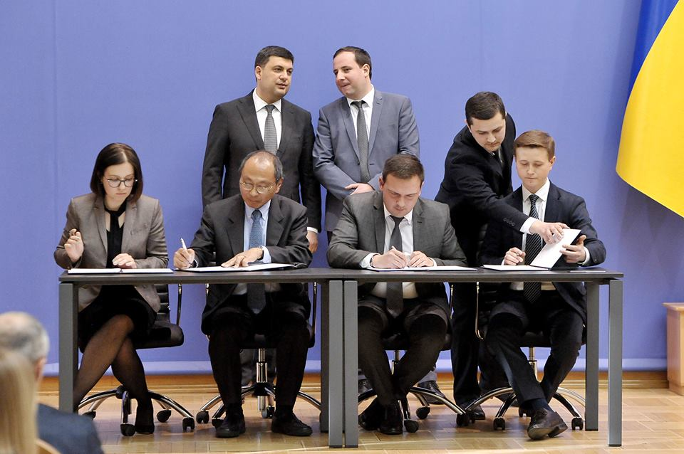
The Memorandum
on Partnership and Strategic Cooperation
Signed on April 23rd, 2018
Francis Fukuyama
and the Governance Project
at CDDRL,
Stanford University

Slide 4
Why?
“Culture eats strategy for breakfast.”
Peter Drucker

Slide 5
What for?
To give an opportunity to the high-ranking government officials and civil servants
to hear one another.
To clear the confusion around the procedures of selection, promotion, and professional development of civil servants.
To better understand civil service culture, locate the weaknesses and develop algorithms for their elimination.
To discover
successful practices and extend them
to the whole system.
To monitor the progress of public administration reform in Ukraine.

Slide 6
Confidential, in-depth interviews and online surveys of civil servants
We are driven by the principles of integrity, sound research, and institutional independence.
In our work we incorporate deep understanding of the local context with the international expertise to deliver impact.
How did We
Accomplish It?
Qualitative assessment of the progress in public administration reform in Ukraine

Slide 7
Methodology
Teams’ areas of responsibility / activities | Inductive qualitative fieldwork |  | Deductive quantitative fieldwork | Deductive qualitative fieldwork | Academic research analysis |  | Consultancy research analysis
PGA team | Exploratory in-depth interviews (open-ended questions) | Exploratory online survey (open-ended questions) | Online survey extra modules (closed questions) | Focus-group discussions to interpret survey findings | Joint academic paper (survey-based) | Separate academic papers | Policy papers
CDDRL team |  |  | Online survey - main modules (closed questions) |  |  | Separate academic papers

Slide 8
Methodology
Research hypotheses formation
Exploratory in-depth interviews
21 insiders 4 target groups of public officials
Confidential, open-ended online survey to discover the cultural barriers
64 new civil servants from 10 ministries under reform
Confidential online survey of ministry-level civil servants and comparative analysis of Ukraine’s bureaucracy with the ones of Brazil, China, India, and the U.S. – in cooperation with the Governance Project at CDDRL.
Focus group discussions (up to 3 discussions expected by April 2019)

Slide 9
Exploratory interviews – research design
21 current and former public officials were interviewed:
10 current civil servants, including 4 experts and director generals
3 former civil servants
1 current politically exposed person
4 former politically exposed persons
3 employees of the Reform Support Teams
17 respondents entered public service (political office/RST) after Euromaidan
8 respondents represent central government bodies without directorates
13 respondents represent central government bodies with directorates
10 women, 11 men

Slide 10
Key findings from interviews and open-ended survey
Civil service reform strategy and goals are not communicated properly
Reform communication does not target " former " civil servants, adversely affecting its current results
Hope and skepticism about the reform are evenly distributed among public officials
Political factor affects competitive selection of civil servants and erodes trust in public administration
"New" civil servants are more autonomous and initiative-oriented than " former " ones
Insufficient coordination of reform by the Reform Delivery Office at the Secretariat of the Cabinet of Ministries
Lack of deep understanding of the local context by some foreign advisors
Insufficient coordination of international technical assistance and weak accountability for
the use of international development aid
23,6% of new civil servants indicated that they don't receive sufficient level of support from their direct managers

Slide 11
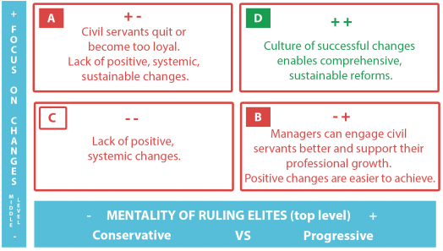
Key findings: our theoretical model

Slide 12
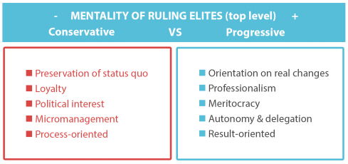
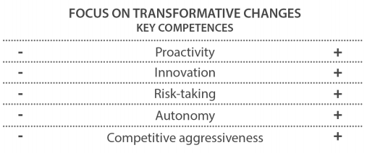
Key findings: our theoretical model

Slide 13
Key Recommendations from interviews and open-ended survey
Update the concept of civil service reform by including the transformation of civil service culture as one of reform objectives. Use the Common Assessment Framework.
Develop a mechanism for evaluating and tracking reform progress at different ministries aimed at continuous improvement of the key elements of the organizational culture of civil service.
Consider a feasibility of setting up a separate Task Force/Office for Innovations & State Transformation aimed at streamlining the governmental efforts to transform the organizational culture of civil service.
Include the basic principles of the competence-based approach at all stages of civil service HR management.
Consider transforming ministerial Cadre Units into modern HRM Units.
Develop and implement a national strategy for training & life-long learning for civil servants.
Improve communication of civil service reform, include “old” civil servants into communication and set incentives for cooperation among “old” and “new civil servants.
International technical assistance projects: use expertise of western-educated Ukrainianians to ensure Ukraine’s self-reliance in transforming its civil service going forward.
Notes:
Regularly evaluate and rank central government bodies based on key elements of organizational culture and reform delivery.
Analyze the feasibility of setting up at NAUCS and SCMU a separate Innovation State Transformation Office (ISTO) on Civil Service Reforms, through a new and innovative reforms’ philosophy of change and Human Resources Management.
Include the basic principles of an international competency-based approach at all stages of working with human resources in the civil service.
The reorganization / reorganization of the HRM departments should be carried out as soon as possible.
NAPA reform and the development of a national strategy for training & life-long learning for the civil servants.
SCMU: more communications and coordination, less expertise, more strategic change management. The reform strategy and its ultimate goals are poorly thought out or not voiced.
International technical assistance projects: use international experience of Ukrainian emigrants within the framework of long-term or short-term technical assistance missions.
Update the concept and strategy of public administration reform of the basis of the Common Assessment Framework.
***
Взяти за основу оновлення концепції реформи української державної служби Common Assessment Framework.
Розробити механізм оцінки та рейтинг реформ по міністерствах, який включав би основні елементи прогресивного розвитку організаційної культури.
Проаналізувати доцільність ствoрення при НАДС та СКМУ окремого Innovation State Transformation Office (ISTO) / Офіс іноваційної державної трансформації з питань реформи державної служби, через нову іноваційну філософію змін та реформи Управління Людськими Ресурсами.
Включити основні засади міжнародного компетентнісного підходу у всіх етапах роботи з людськими ресурсами на державній службі.
Необхідно якнайшвидше провести реорганізацію/реструктуризацію відділів персоналу та забезпечити умови для створення повноцінних департаментів з Управління Людськими Ресурсами.
Реформа НАДУ та розробка національної стратегії підготовки/підвищення кваліфікації державних службовців.
SCMU: більше комунікацій та координації, менше експертизи, більше стратегічного управління змінами. Стратегія реформи та кінцеві цілі слабко продумані або не озвучуються.

Slide 14
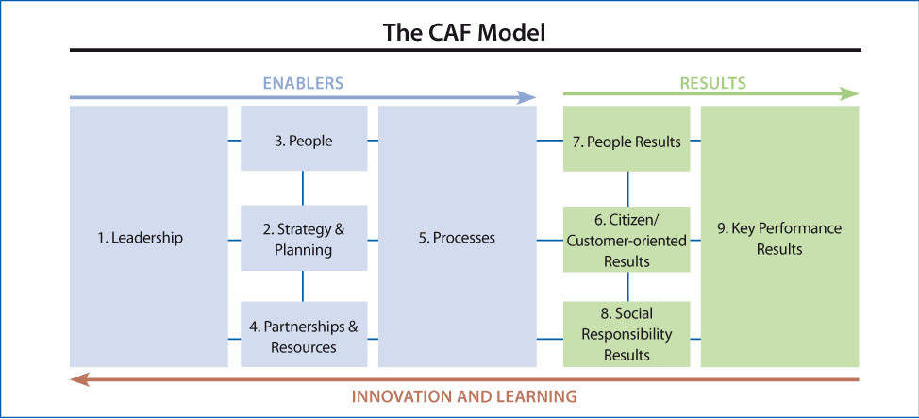

Slide 15
Confidential online survey of civil servants from 14 ministries and the Secretariat of the Cabinet of Ministries – jointly with the Governance Project at the CDDRL, Stanford University
Over 1,800 civil servants (response rate – about 45 percent) took part in the survey on key parameters of a modern civil service, as meritocracy, autonomy, morale, and effectiveness, as well as other parameters identified during the 1st phase interviews and survey of new civil servants.
This will allow for the better understanding of the organizational culture of civil service, and the development of comprehensive recommendations to address challenges to Ukraine’s civil service.

Slide 16
Expected Results
Reports to the government and civil society, deepening the understanding of civil service culture and ways to transform it for the better.
Civil service receives a refined, valuable tool for assessment, reflection and feedback, which will allow for its continuous improvement.
Established community of professionals that deeply understands and analyzes civil service culture, state capacity, and tracks progress in civil service reform.
Ukrainian society benefits from civil service of a better quality.

Slide 17
Added Value & Plans for the Future
Understanding of the current organizational culture of civil service in Ukraine.
Comparing governmental bodies in terms of the civil service culture.
Enhancing public administration through change in the civil service culture.
***
Compare the civil service culture in Ukraine with the one in Brazil, China, India and the USA.
Institutionalize an annual civil service survey in Ukraine.
Track changes in civil service culture over time.

Slide 18
Opportunities for cooperation
International comparative analysis based on data recived from five countries: USA, China, India, Brasil and Ukraine.
EU countries?
Eastern Partnership countries?
Other countries, primarily post-soviet ones?
PGA works to establish in Ukraine a Regional Hub for Civil Service Excellence.
We are open to opportunities for cooperation aimed at advancing public administration in Ukraine and internationally.

Slide 19
Civil Service Feedback Loop
THE FIRST STUDY OF CIVIL SERVICE CULTURE IN UKRAINE
IN COLLABORATION WITH FRANCIS FUKUYAMA AND THE GOVERNANCE PROJECT
AT THE CENTER ON DEMOCRACY, DEVELOPMENT, AND THE RULE OF LAW,
STANFORD UNIVERSITY
If you’ve got a question or feedback, we’d like to hear from you. Please send us an email to:
proukrgov.ua@gmail.com

